Slide 1

The
Marshmallow
Challenge

Slide 2
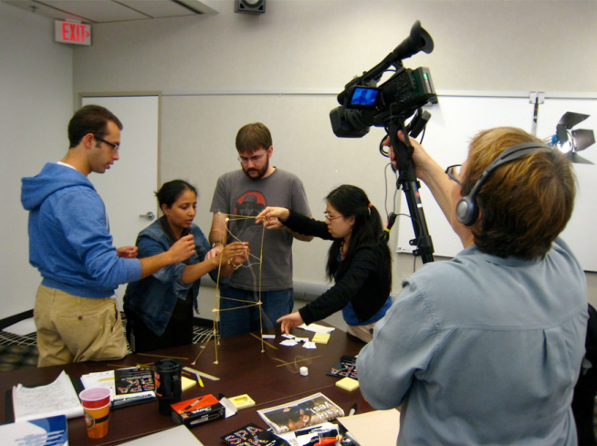

Slide 3
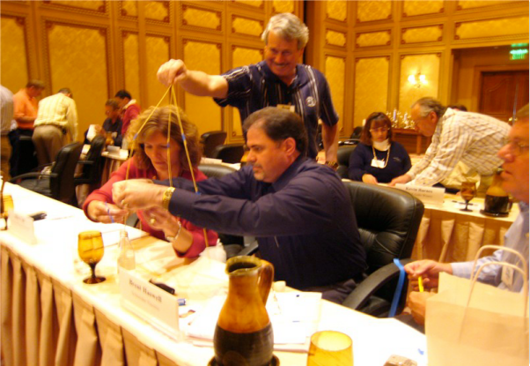

Slide 4
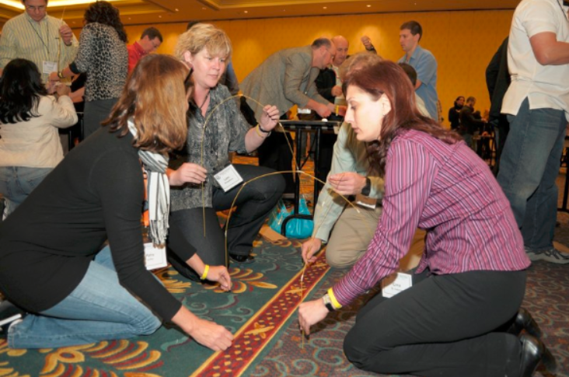

Slide 5


Slide 6



+
+
20 sticks
spaghetti
1 meter
tape
1 meter
string

Slide 7

+
+
20 sticks
spaghetti
1 meter
tape
1 meter
string

Slide 8

+
+
20 sticks
spaghetti
1 meter
tape
1 meter
string

Slide 9

+
+
18 minutes
20 sticks
spaghetti
1 meter
tape
1 meter
string

Slide 10
Rules:
It must be a free STANDING structure.
You cannot be touching or holding on to the structure after 18 minutes.
Use as much or as little of the kit as you want except the paper bag and scissors.
The entire marshmallow must be on top. Do not eat the marshmallow or cut it into pieces.
+
+
20 sticks
spaghetti
1 meter
tape
1 meter
string

Slide 11
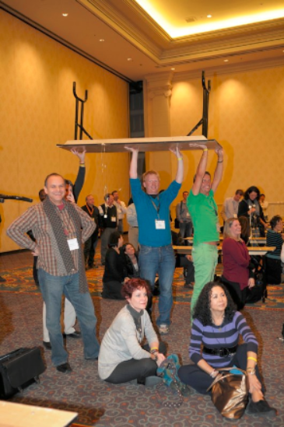

Slide 12
Rules:
It must be a free standing structure. You may tape down the legs if you wish.
You cannot be touching or holding on to the structure after 18 minutes.
Use as much or as little of the kit as you want except the paper bag and scissors.
The entire marshmallow must be on top. Do not eat the marshmallow or cut it into pieces.
+
+
20 sticks
spaghetti
1 meter
tape
1 meter
string

Slide 13


Slide 15
The
Marshmallow
Challenge

Slide 16

Typical Progress
18
minutes
Start

Slide 17
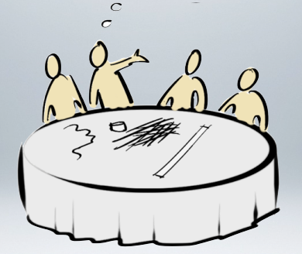
Typical Progress
18
minutes
Start
Orient

Slide 18

Typical Progress
18
minutes
Start
Orient
Plan

Slide 19
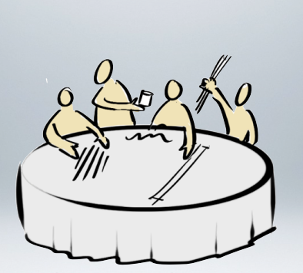
Typical Progress
18
minutes
Start
Orient
Plan
Build

Slide 20

Typical Progress
18
minutes
Start
Orient
Plan
Build
Ta-Da!

Slide 21

Typical Progress
18
minutes
Start
Orient
Plan
Build
Oh-No!

Slide 22
Lesson One:
The Importance
of Facilitation

Slide 23
What
type of team
consistently shows
Poor
Performance?

Slide 24
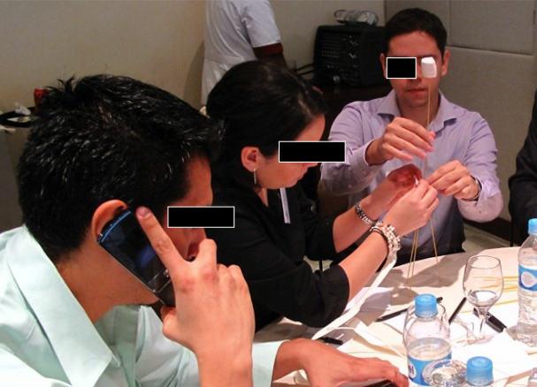
Recent Graduates of Business School

Slide 25
What
type of team
consistently shows
Great
Performance?

Slide 26
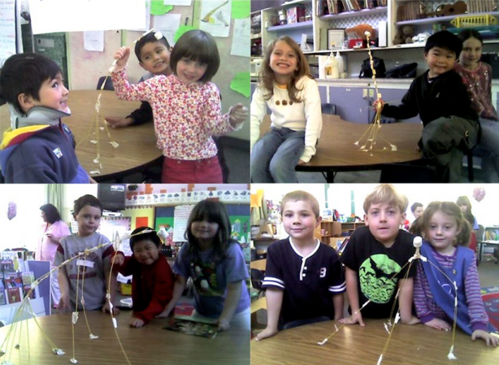
Recent Graduates of Kindergarten

Slide 27
30
20
10
0
Average

Slide 28
30
20
10
0
Average
Business School Students

Slide 29
30
20
10
0
Average
Lawyers
Business School Students

Slide 30
30
20
10
0
Average
Lawyers
Business School Students
Kindergarten Students

Slide 31
30
20
10
0
Average
Lawyers
Business School Students
Kindergarten Students
Architects & Engineers

Slide 32
30
20
10
0
Average
Lawyers
CEOs
Business School Students
Kindergarten Students
Architects & Engineers

Slide 33
30
20
10
0
Average
Lawyers
CEOs
Business School Students
Kindergarten Students
Architects & Engineers
CEOs + Exec Admins

Slide 34
30
20
10
0
Average
Lawyers
CEOs
Business School Students
Kindergarten Students
Architects & Engineers
CEOs + Exec Admins

Slide 35
30
20
10
0
Average
Lawyers
CEOs
Business School Students
Kindergarten Students
Architects & Engineers
CEOs + Exec Admins

Slide 36
Lesson Two:
The Importance
of Incentives
& Experience

Slide 37
Average Team Performance
30
20
10
0
1
2
3
4
5
6
7
8
9
10
Teams

Slide 38

Incentive
30
20
10
0
1
2
3
4
5
6
7
8
9
10
Teams

Slide 39
Average Team Performance
30
20
10
0
1
2
3
4
5
6
7
8
9
10
Teams

Slide 40
Incentivized Performance
30
20
10
0
1
2
3
4
5
6
7
8
9
10
Teams

Slide 41
Incentivized Performance
Four
30
Months
20
Later...
10
0
1
2
3
4
5
6
7
8
9
10
Teams

Slide 42
Average Team Performance
30
20
10
0
1
2
3
4
5
6
7
8
9
10
Teams

Slide 43
Incentivized Performance
30
20
10
0
1
2
3
4
5
6
7
8
9
10
Teams

Slide 44
Incentives Alone
30
20
10
0
1
2
3
4
5
6
7
8
9
10
Teams

Slide 45
Incentives + Experience
30
20
10
0
1
2
3
4
5
6
7
8
9
10
Teams

Slide 46
Lesson Three:
The Importance
of Small
Wins

Slide 47
Why?
Fail
Win

Slide 48


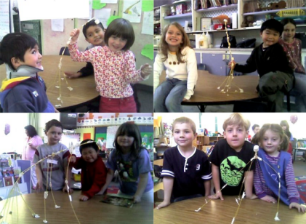
18
minutes
Start

Slide 49
Find the best plan & execute
Focus on the structure
18
minutes
Start
Focus on the marshmallow
Play, prototype, experiment

Slide 50
Lesson Four:
The Importance
of End Goals
& Assumptions

Slide 51


Slide 54
The
Marshmallow
Challenge

Slide 55
Special Thanks:
We are grateful to Tom Wujec for making his original Marshmallow Challenge
materials available to the world!
Learn more at:
marshmallowchallenge.com

Slide 56
Notes on lessons learned:
As you will see by comparing Wujec’s orginal notes with my own presentation, I modified the main points in order to speak more directly to partnership principles.
Lesson 1. The Importance of Facilitation
Wujec talks about the supercharged effect of having facilitation skills on a team (represented by the executive admins on the CEO teams). The point he makes is right on target with what we have seen for decades in the field of missional collaboration. An effective partnership has a dedicated facilitator, someone who serves the entire partnership in a neutral role and gives time and attention to the process of working together.

Slide 57
Lesson 2. The Importance of Incentives & Experience
Wujec makes the point that incentives alone are not sufficient to improve performance. Practice improves performance. I believe this underscores first of all the importance of orienting new partners or members coming into the partnership/network. People will have widely varying experience in collaboration. I believe this also underscores the importance of constantly reinforcing the values and skills of collaboration among the partners. The best training ground for facilitators of new partnerships is within existing partnerships.

Slide 58
Lesson 3. The Importance of Small Wins
Wujec talks about the value of prototyping in his presentations. In a partnership context, I believe this aligns with the principle of “limited achievable objectives.” Many inexperienced partnerships try to take their big vision, make accordingly big plans, and – when they achieve only small wins – begin to exhibit disappointment and discouragement. More experienced partnerships take their big vision, break it down into limited achievable objectives, and – when they achieve small wins along the way – celebrate their progress and reflect on their learning. On the one side, small successes lead to disappointment and discouragement. But on the other side, a progression of small successes leads to celebration and encouragement to pursue larger objectives. Working together successfully toward small wins maintains enthusiasm and confidence, helps partners know how to best work together (and what strengths each brings to the partnership), and encourages partners to work toward successively greater goals.

Slide 59
Lesson 4. The Importance of End Goals & Assumptions
Wujec makes the the point that the marshmallow is a metaphor for testing the hidden assumptions in every project. The same is true in the context of partnerships. Effective partnerships stay focused on the end goal and constantly question and test their assumptions. We think marshmallows are light and fluffy, but in fact it is quite difficult to build a tall structure (even with rigid spaghetti sticks) that can support a single marshmallow. The big idea here is the principle of “function over form.” We need to let the outcomes of the partnership (its function) determine any considerations of structure/logistics/activities/etc. of the partnership (its form). It is very easy to get sidetracked by the day-to-day operational issues of partnering and lose sight of our end goals along the way. We make assumptions, not only about the “marshmallow” (our end goals) but also about the “spaghetti” (the partnership structures & activities) that support the marshmallow. I believe it is important for leadership teams to use a tool or approach such as an “outcomes model” or “logic model” that can facilitate deep discussion about assumptions. When we consider the flow of resources to activities to outcomes to impact, we make many “if / then” assumptions along the way. It is important to test those assumptions.

